Slide 1
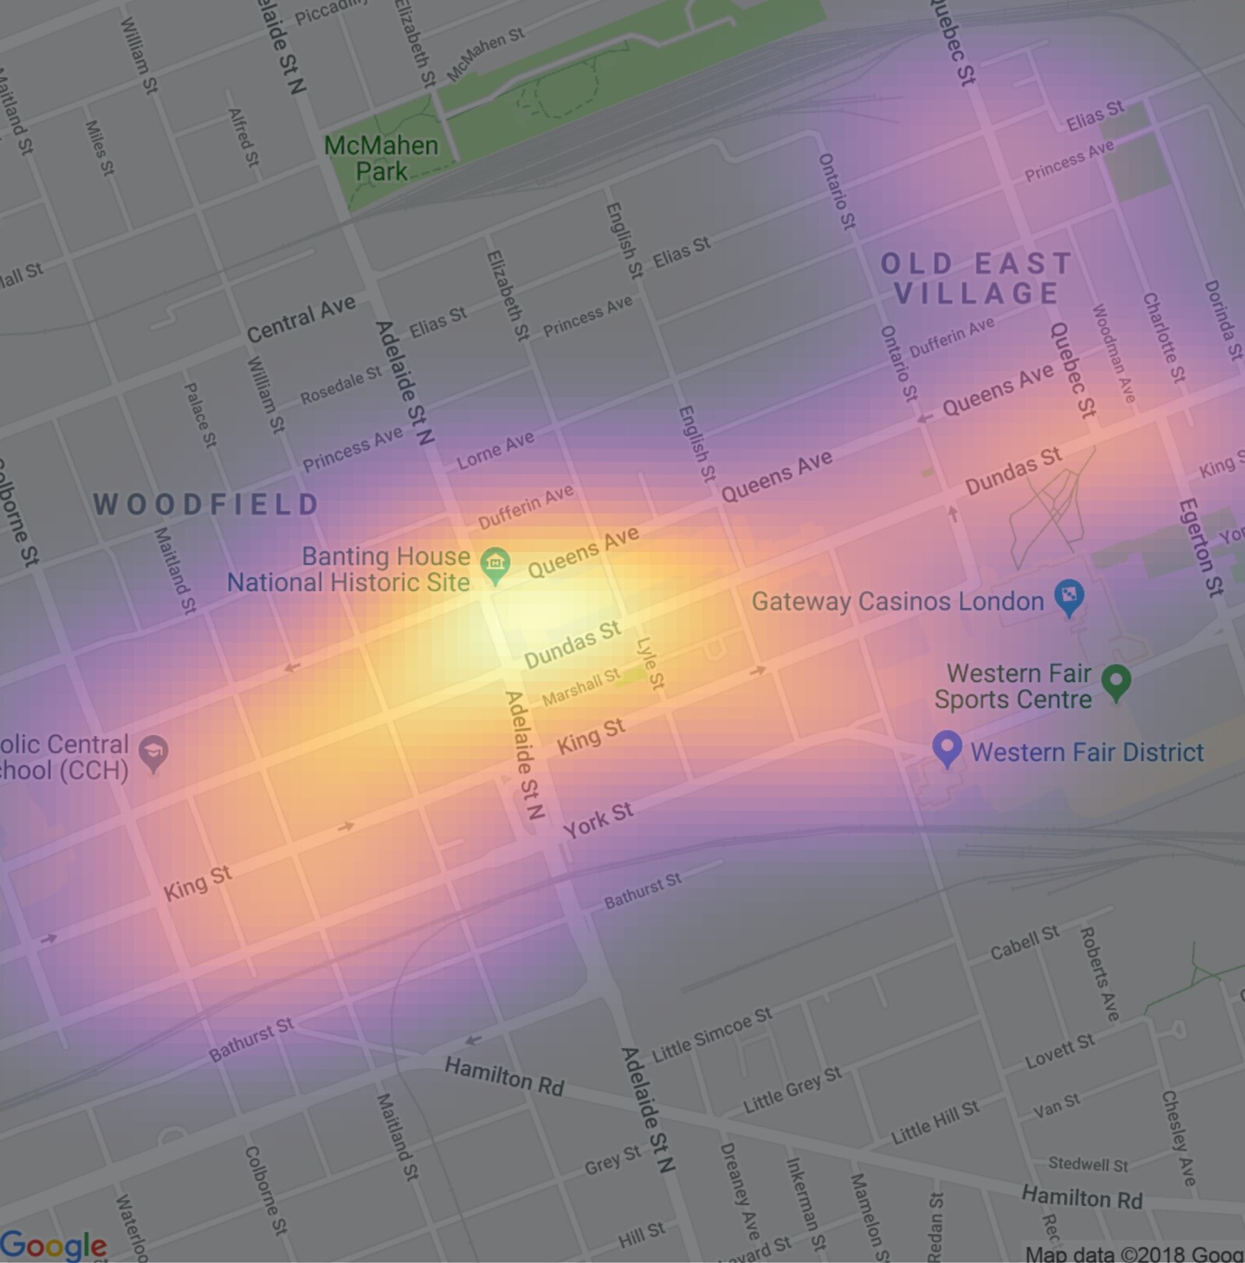
R-Ladies!
Pointmaps and Heatmaps
Rebecca Henderson, MSc, PhD candidate
Student in Measurement and Methods, Faculty of Health Sciences
Contact: rhende9@uwo.ca
March 28, 2019
(Cycling Advisory Committee for parking data)
Notes:
I want to thank the Cycling Advisory committee for the data
The reason I wanted to learn this in the first place was because I’m studying cycling collisions in London.
The heatmaps are a tool of data visualization broadly widely used with biological data. The concept is to represent a matrix of values as colors where usually is organized by a gradient. We can find a large number of these graphics in scientific articles related with gene expressions, such as microarray or RNA-seq.
Heatmaps are everywhere these days. You see them on the weather, on real estate sites – basically, anywhere there’s data to display.
They’re increasingly popular in scientific disciplines where large volumes of data have to be made comprehensible.
That’s because they’re a great way to see through data to trends and understand what to do next.
And while we may think of heatmaps as a 21st-century thing, it turns out they have their roots in the statistical analysis techniques of the 19th century.
Now heat maps are the most-used tool for representing complex statistical data. Doctors, engineers, marketers, sociologists, and researchers of every kind use heat maps to make complex data sets comprehensible and actionable.
That’s the secret to their success: charts have to be interpreted, tables have to be understood, but heat maps are self-explanatory, intuitive.
Sounds great. So what am I looking at?
What is a Heat Map?
A heat map is data analysis software that uses color the way a bar graph uses height and width: as a data visualization tool.
If you’re looking at a web page and you want to know which areas get the most attention, a heat map shows you in a visual way that’s easy to assimilate and make decisions from.
Are heatmaps good for bike parking? No!
heat map (or heatmap) is a graphical representation of data where the individual values contained in a matrix are represented as colors. It is a bit like looking a data table from above. It is really useful to display a general view of numerical data, not to
extract specific data point. It is quite straight forward to make a heat map, as shown on the examples below. However be careful to understand the underlying mechanisms. You will probably need to normalise your matrix, choose a relevant colour
palette, use cluster analysis and thus permute the rows and the columns of the matrix to place similar values near each other according to the clustering.

Slide 2

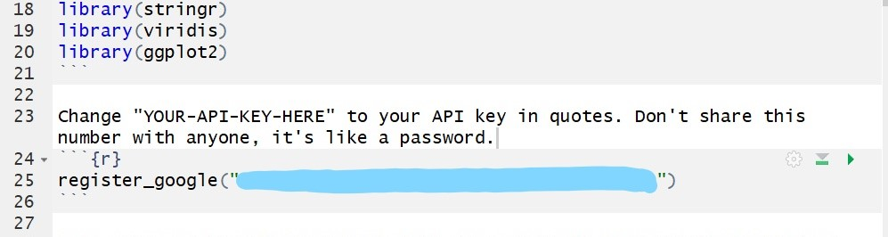
Google maps API key (application programming interface)
We are a design studio based on Europe. We create presentations that sells. True!
Notes:
What is it? Application programming interface key
If you’ve joined us today without getting your API key, or if you joined us for the snacks,
Use APIs to get access to data or functionality, or in our case, we want to access Google Maps.
The API key becomes a personal identifier. And, it identifies what requests you’re making, and how often you are making requests. It logs these requests and then sends you the appropriate data. So, the data I’ve been asking for is a map of London, On.
Now, this identifier is associated with your VISA account, so don’t share this number with anyone. It’s like a password.

Slide 3
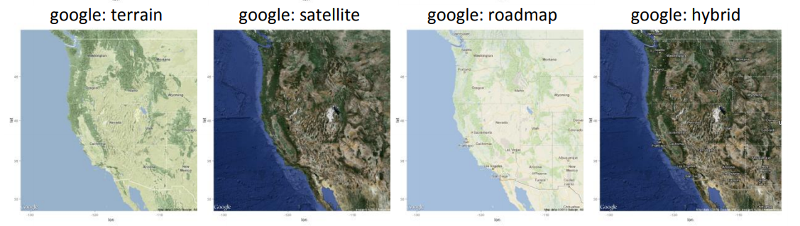
get_googlemap
https://www.nceas.ucsb.edu/~frazier/RSpatialGuides/ggmap/ggmapCheatsheet.pdf

Slide 4
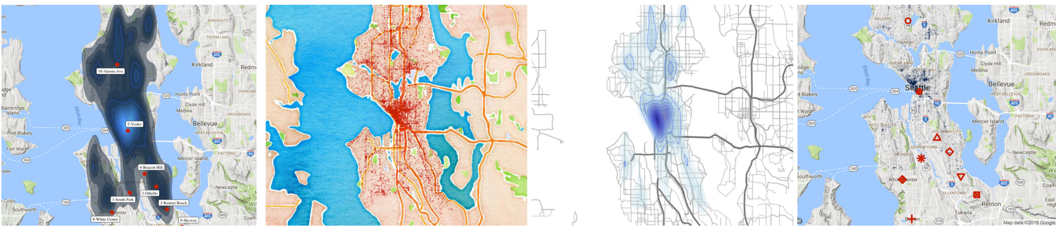
get_googlemap
https://www.littlemissdata.com/blog/maps
Data: dangerous neighbourhoods
Notes:
Here, they’re using heatmaps to look at crime in Seattle. Perhaps if you’re moving Seattle, this may be important to you. Or, perhaps you want to choose a home based on voting preferences. You may be more inclined to live in a red or a blue neighbourhood. Heatmaps can quickly give us information particularly for social concerns: income, education, crime, religion
Heatmaps can be used to represent population density, per-capita income, social views, and many other geographically important measurements.

Slide 5
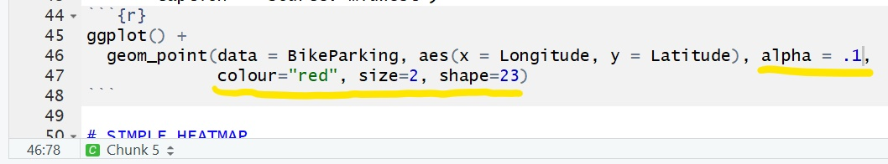
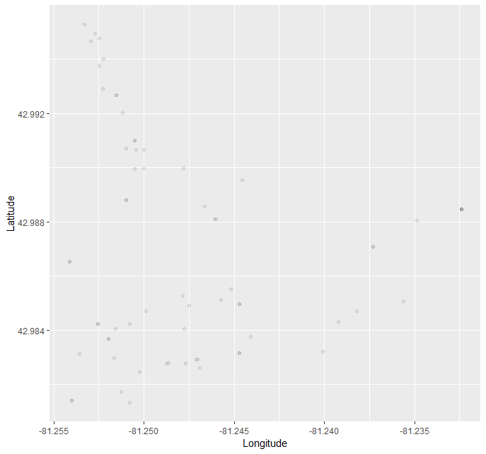
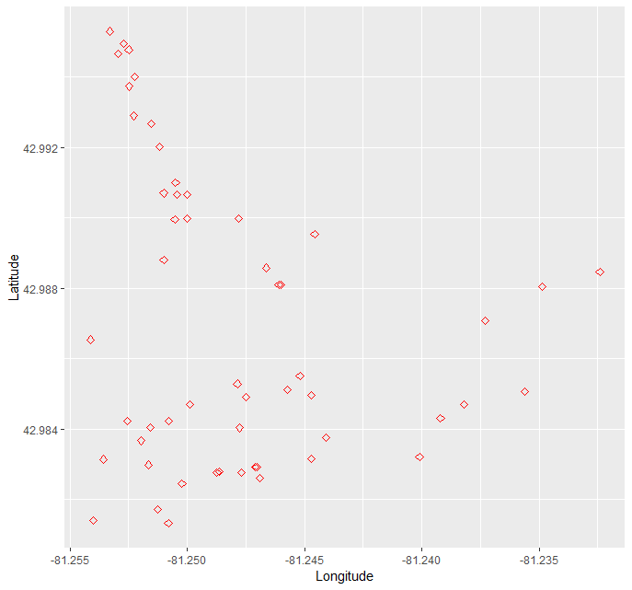
Scatterplots Each point represents a bike parking spot in downtown London
Notes:
The scatterplot represents the bike parking spaces.

Slide 6
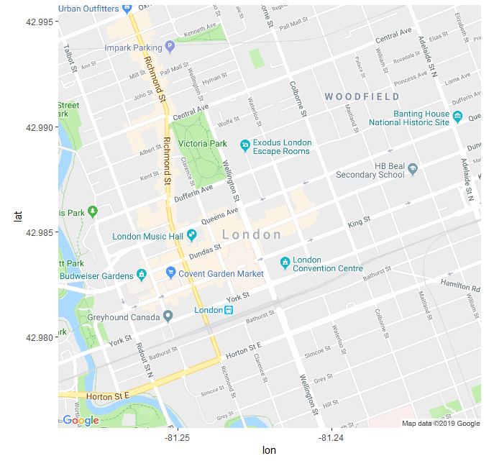
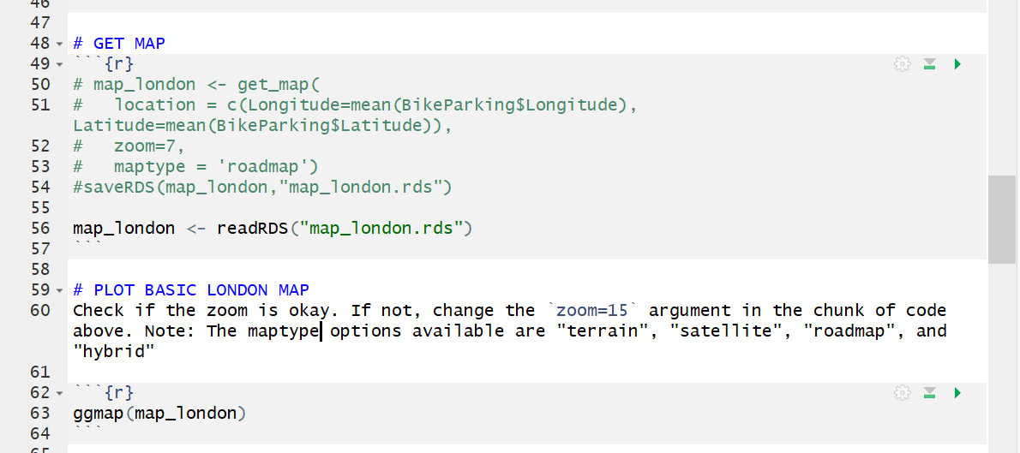
Get London map
Notes:
I wanted to include this information about .rds
You can save your map to your working directory, and then you can read your map when you’re offline because it’s now saved to your drive.
RDS means R Data Structure

Slide 7
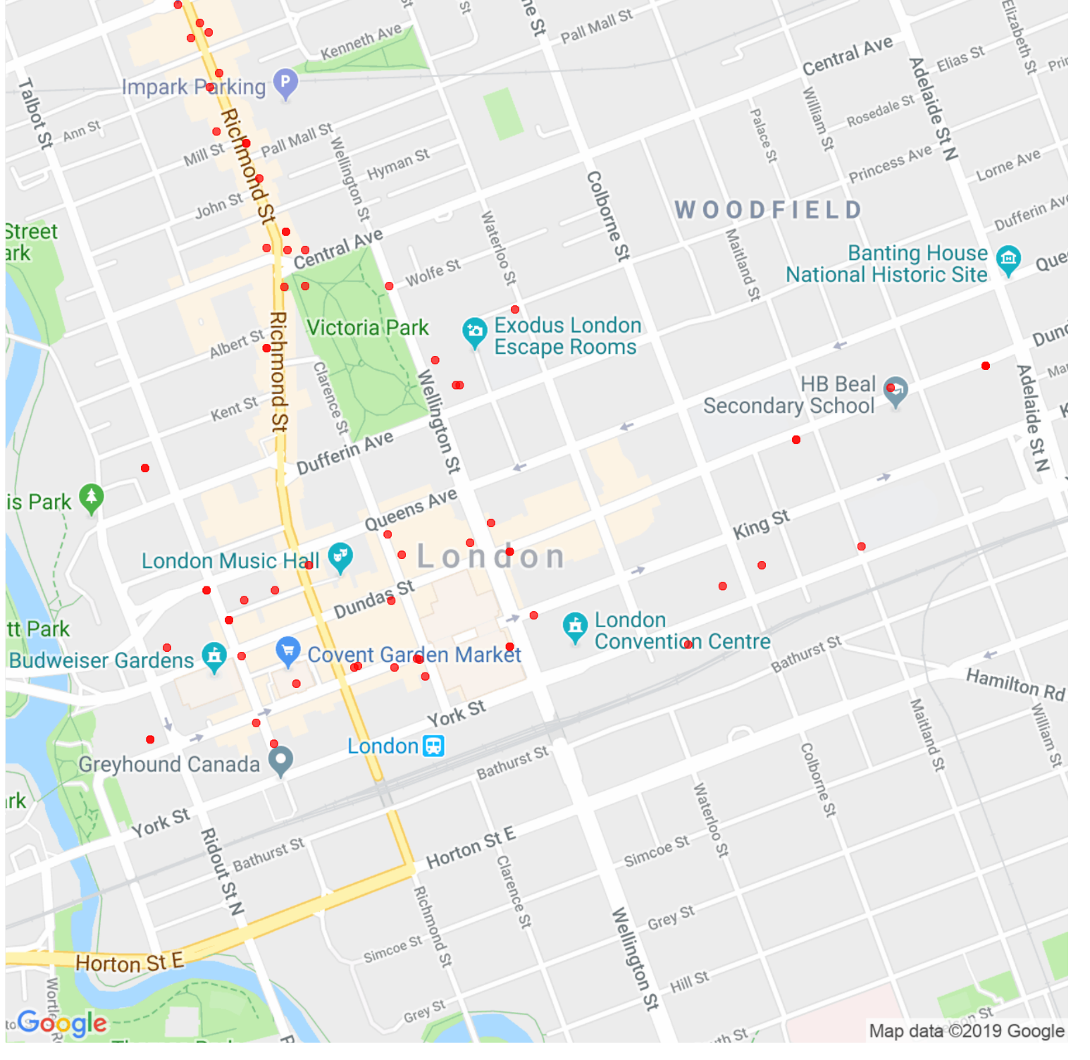
Pointmap #1 Our first pointmap
Notes:
But, in scatterplots, you can change how you want your image to look. In our case, I changed the transparency using <alpha>. Can anyone guess why we changed the transparency in this case? Right! I wanted to get a visual of the overlap. You can see over here, that it’s quite darker, so I know that there is the same longitude and latitude for multiple points. I can already see that there’s a few bike parking spots.
Aes – this describes the characteristics of each point.
- colour, size,

Slide 8
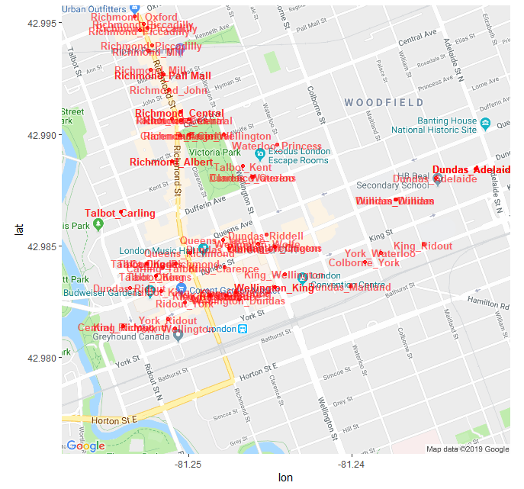
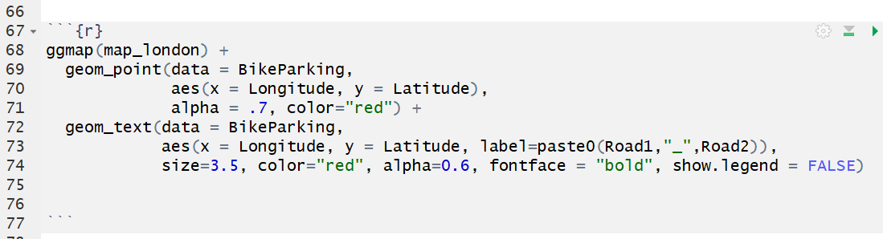
Pointmap #2
Notes:
This is a really terrible map but I promise that it’s a good learning slide.
First, let’s remember what we’re doing with “aes”. AES describes the characteristics of each point.
Right now, we have 4 observations. We have lon and lat, and we have road 1 and road 2.
But, there’s a bit of confusion that I hadn’t originally thought of. You and I know that Dundas St and William St are the same as William St and Dundas St. But, we need to sort these into alphabetical order.
And, later for the heatmap, we’re going to tell it to count those observations
I wanted to keep this in the script because when I was playing around to see what I could do with the maps, I made this one. Now, it doesn’t work for my needs. But, I wanted to keep it in for you, just in case this makes sense for your data!
I’m grouping the observations of Road 1 and Road 2. But, your labels may be your favourite local restaurant where it may make sense.
The other thing you can do here is
The other reason, I wanted to use this is because I learned there are some mistakes with my data. If you see over here, this says that the closest intersection is William and Dundas, and that’s not accurate because William and Dundas are over here. And, I saw that I needed to work at my data a bit. As you can see William St and Dundas is the same thing at Dundas St and William St. but we need to tell the program that. You may also need to reorganize your data, too. And, I’ve included how to do that in the script.

Slide 9
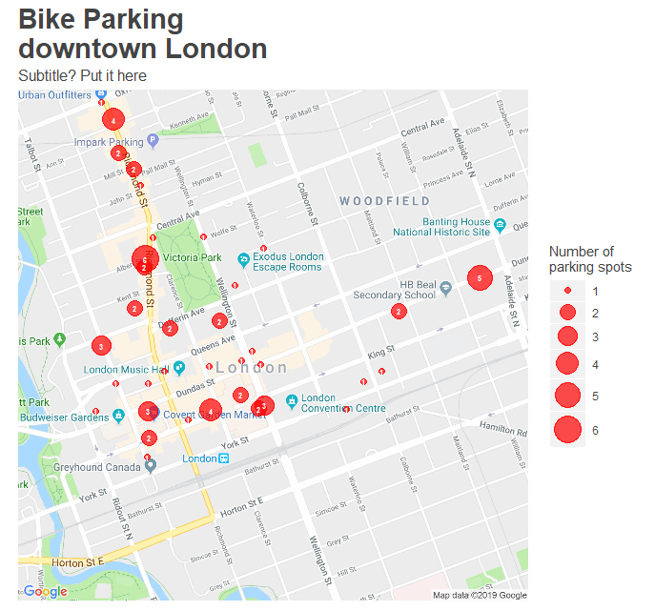
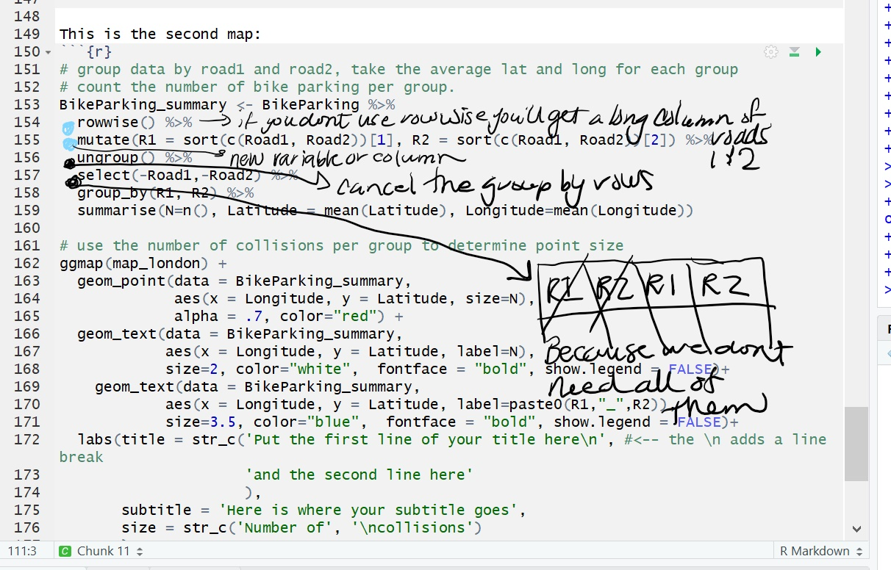
Pointmap #3
Notes:
Remember for mutate, we add new variables but for summarize we’re calculating the new data set. So we’re aggregating the new data set, or we’re forming it into a new cluster.
We have four variables here. We have lat and lon, and we also have road 1 and road 2. So we could turn these observations into 1. The other thing is that you can take these four
N is important because it’s used to label each point and the size of each point. So, for now, we ignore Road 1 and Road 2.

Slide 10
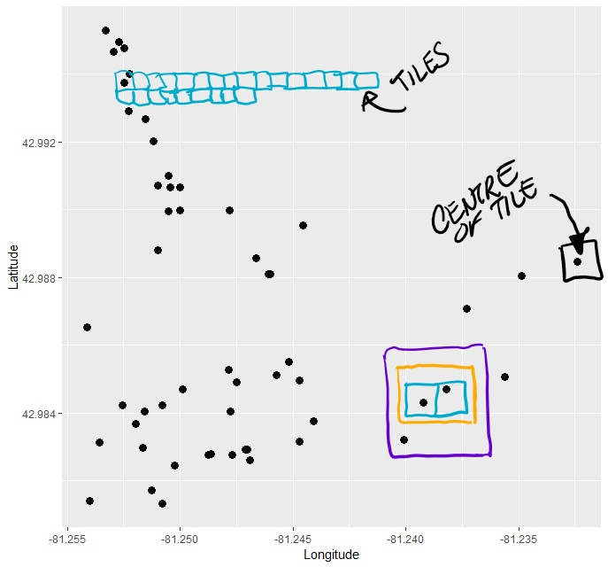
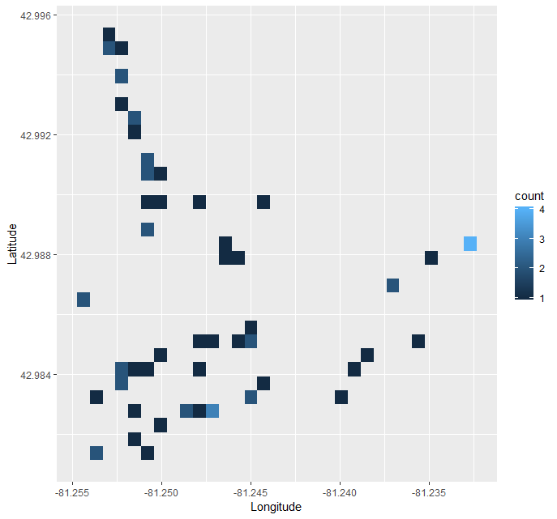
We’ve got heat!
(Without the maps)
Notes:
I think it’s important to talk about what’s happening before we get to the heatmap.
Divides the plane into rectangles, counts the number of cases in each rectangle, and then (by default) maps the number of cases to the rectangle's fill. This is a useful alternative to geom_point() in the presence of overplotting. You can change the size of your rectangle. This is your binwidth, you could change the size to an entire city block
The heatmap is going to use each point as it’s centre.
The first map is our original map and we’ve used transparency.
The second map, I changed the transparency because I wanted you to be able to see the points and what’s happening in the heatmap When we get overlap, it becomes labelled by the same rectangle, so we have to assign a different colour when there’s overlap. In our case, the lighter colours mean that there’s more counts of bike racks in that area. This is something that we can’t see in the scatterplot because the

Slide 11
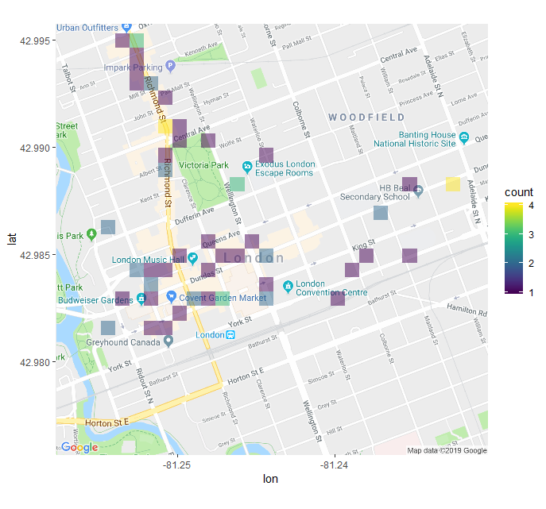
HEATMAPS!
(We got there! And, changed our colour palette)
Notes:
Let’s talk about what’s happenng here.
One of the things I wanted to talk about is “Density”. It’s called “density” but really it’s “intensity” is the relative meaning, not absolute meaning.
And, in our case we only have x and y. but, we could also have z. And, z could relate to another variable of the point. Perhaps each bike parking spot is rated on its quality.
You change the colour palette in the code. This is called viridus

Slide 12


Polished maps practice
Pointmaps
ggmap(map_london) +
geom_point(data = BikeParking_summary,
aes(x = Longitude, y = Latitude, size=N),
alpha = .7, color="red") + [Challenge: change the alpha (transparency) and colour of your points]
geom_text(data = BikeParking_summary,
aes(x = Longitude, y = Latitude, label=N),
size=2, color="white", fontface = "bold", show.legend = FALSE)+ [Challenge: change the size, colour, type of font of your points]
Heatmaps
stat_bin_2d(data = BikeParking, aes(x = Longitude, y = Latitude, fill = stat(count)),
binwidth = c(0.001, 0.001) [Challenge: change your binwidth to 0.003 or higher]
geom = 'tile', alpha=.5) + [Challenge: change geom = ‘polygon’, what happens? When would this be useful?]
scale_fill_viridis(option = 'plasma’) + [Challenge: change option = ‘magma’ or ‘inferno’ or ‘cividis’]
labs(title = str_c('Bike parking\n', #<-- the \n adds a line break
'downtown London’ + [Challenge: change your title!]
Thanks everyone!
Notes:
What are the things that you can play with?

